Slide 1
REV vs WCP/CTRE motors/motor controllers and the basics of how to use them.
Martin (1086) & Enoch (10257)
All information here is relevant to the 2026 season, and subject to change in 2027 when SystemCore comes out.

Slide 2
REV, CTRE & WCP - Product Line Highlight
REV Robotics
Engineers & assembles Spark series of standalone motor controllers
Builds & designs the Neo series of brushless dc motors.
CTRE (Cross the Road Electronics)
Created the TalonFX Integrated motor controller
TalonFX is used in the Kraken x44, x60 by WCP (West Coast Products), and Falcon 500 by VEX Robotics.
Also designed the TalonFXS Standalone motor controller.
Notes:
Bullet pointed version.

Slide 3
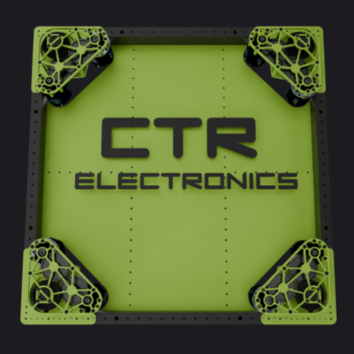
Benefits of REV/CTRE Motors/Motor Controllers
REV Spark Series of Motor Controllers:
Semi Open Source API
Low Price compared to CTRE
Provided Template code for Swerve
CTRE Talon FX Series of Motor Controllers:
Built in Mechanism/Differential and Swerve API
Ability to Sync with external CTRE encoders and sensors
Code generation for Swerve and Elevator through Tuner app
Supports multiple CAN Buses in the 2026 season
All information here is relevant to the 2026 season, and subject to change in 2027 when SystemCore comes out.
Swerve Base Source: CTRE Tuner X Application

Slide 4
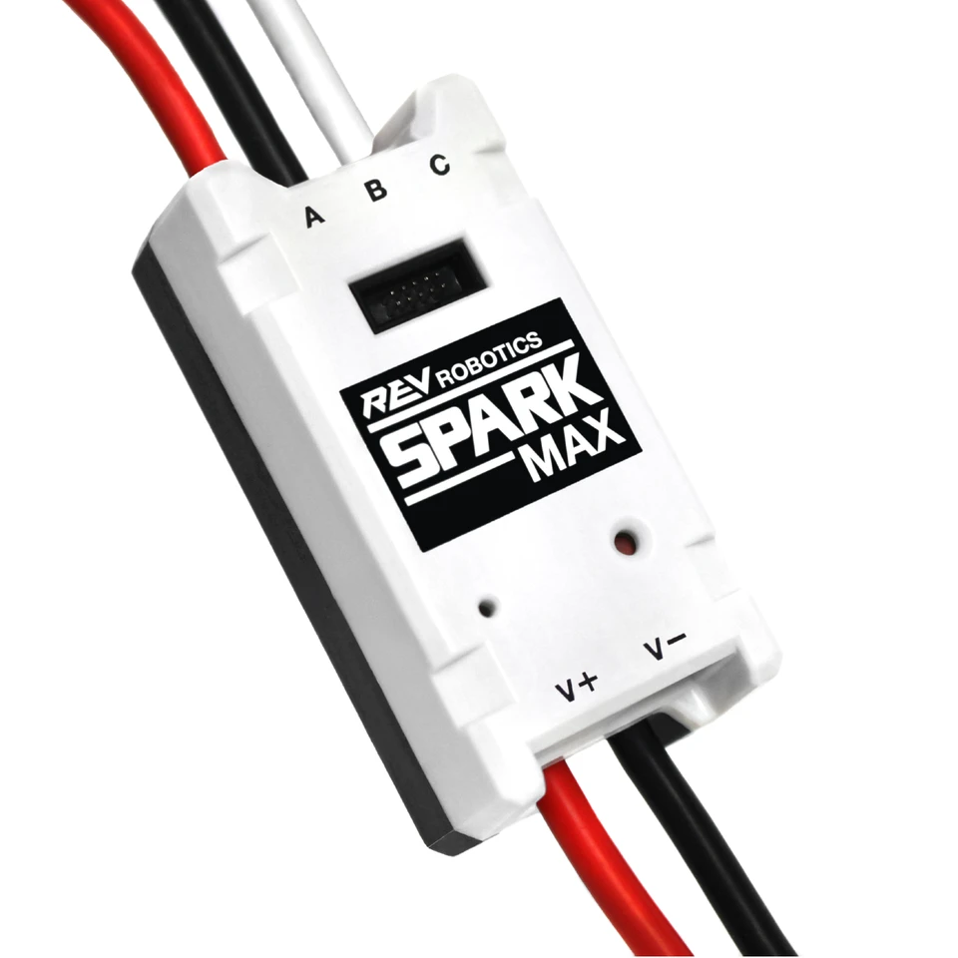
Programming/API Libraries Overview:
Unfortunately these motors do not use the library or a common api for calling them besides the Hardware Abstraction Layer api, which is too complicated and uncommonly used on the user side to be worth explaining here, this is focused on basics of using the already existing api. For this presentation, we will be explaining the main differences between each vendor’s main library for brushless motors, which is REVLib for REV Robotics & Phoenix 6 for CTRE/WCP.

Slide 5
Important Notes about the libraries
All Libraries have classes with the motor controller’s name and it does not use the motor’s name.
These libraries do not share much commonalities therefore it is important you look at the documentation to learn how to effectively use each one.
Somethings while being similar on either motor controller might be named differently or controlled another way.

Slide 6
Programming Libraries - Agenda/TOC
REVLib overview
Creating a motor controller object with a SparkMax as an example
Configuring motor controller
Open Loop/Closed Loop Control
Getting Data
Phoenix 6 overview
Creating motor controller object with TalonFX as an example
Configuring the motor controller object
Phoenix 6 controls api explained
Phoenix 6 status signal api explained
Notes:
This is put after it so people can see the order of the apis that we will teach them.

Slide 7
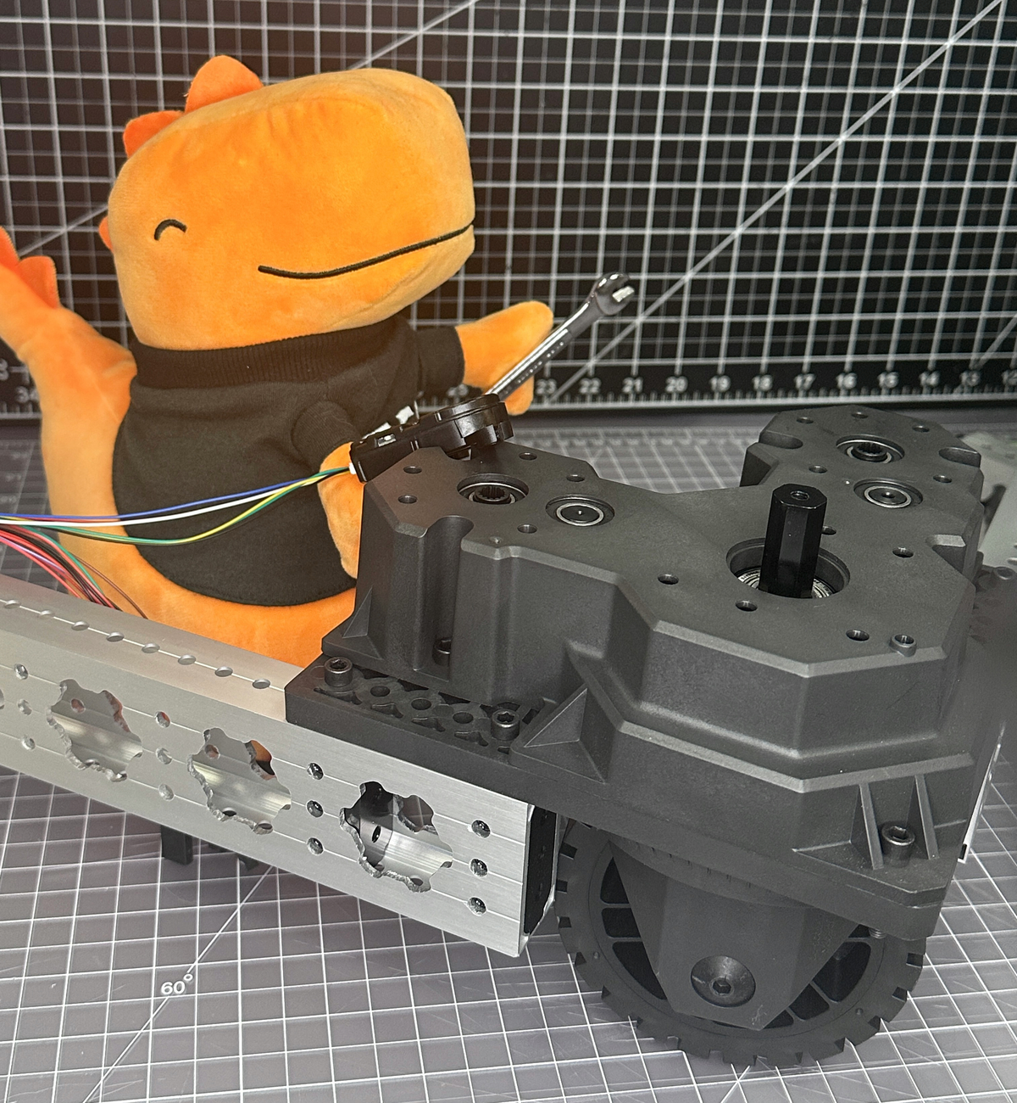
REVLib Overview
REVLib is Rev Robotics’ vendor library. It is the library that will be used for all REV Robotics products that do not connect directly to the rio/systemcore over something other than CAN. You can install it like any other wpilib vendor dep by going to the vendor dependencies page, and click install next to Revlib.

Slide 8

REVLib - Creating a Motor Controller Object
You can create a motor controller in a WPILib project once you have installed the correct library, in this case revlib.
Here is a list of steps in order of how you can create a motor controller object
Install the correctly library (REVLib in this case)
Figure out what motor controller class belongs to what controller class, in this case we are using the SparkMax, and in REVLib it is called “SparkMax”
Instantiate an object of that class for example - new SparkMax(1, MotorType.kBrushless); The 1 in the parameter references the CAN ID of the motor. The second parameter “MotorType.kBrushless” is referring to the type of motor connected to the spark max since both the Spark Max and Spark Flex support both brushed and brushless motors.
↑ Example of instantiating a spark motor controller in a subsystem

Slide 9
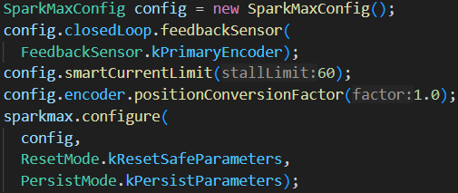
REVLib - Configuring a Spark Motor Controller
In order to configure a REV Spark Motor Controller you must do the following
Create an object of the config class belonging to the correct Rev Motor Controller you are using, it is normally motor controller name with no spaces + “Config”
You then configure it with the built in functions like config.smartCurrentLimit(60). This example function configures the stall current of the motor. It is necessary to read the docs or other’s code to see what each function does and how to correctly use it.

Slide 10


REVLib - Spark Motor Controller Closed Loop
The Spark series of motor controllers features on onboard pid controller that you can take advantage of in code. You must configure the correct feedback sensor and gains in the spark max configuration before using it, I(the guy writing this presentation) found that out the hard way. You can follow the following steps to utilize it.
Create the closed controller object by calling <spark series controller>.getClosedLoopController(). It is typically an object of the “SparkClosedLoopController” class.
You can then reference the closed loop controller in code later on for closed loop functions like position by using <controller object>.setSetpoint(0.0, type)
The first parameter is the desired setpoint of the controller
‘The second parameter is the desired type of control for example, velocity or position.

Slide 11
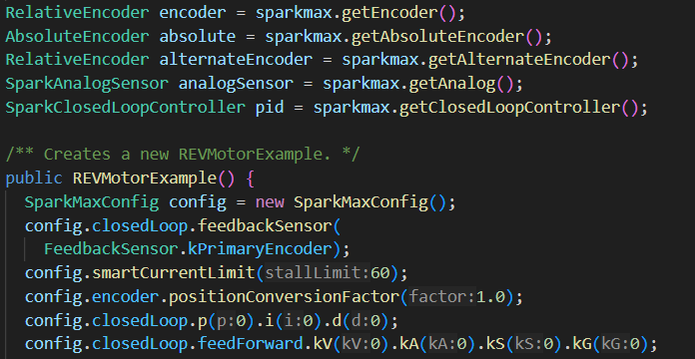
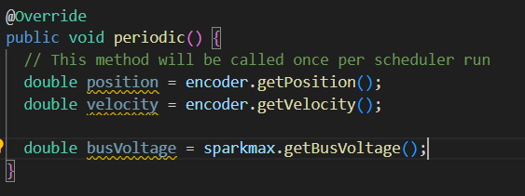
REVLib - Reading Motor Data
Like most other motor controllers, the Spark family allow you to read the data from both the connected encoders and motors in your java code. In order to read position or velocity data from a Spark series of motor controller you must first get the encoder object of the encoder connected to the spark max which typically is 1 of 3 types, motor encoder, alternate encoder, and absolute encoder. You can then get the relevant data such as position by simply calling a function like getPosition or getVelocity in the example. If you want to get motor data such as the supply voltage of the motor controller, you can do that by using get+<desired data>. You might not get the desired amount of data with the spark series of motor controller, so it is helpful to check the docs to see what you can do.

Slide 12
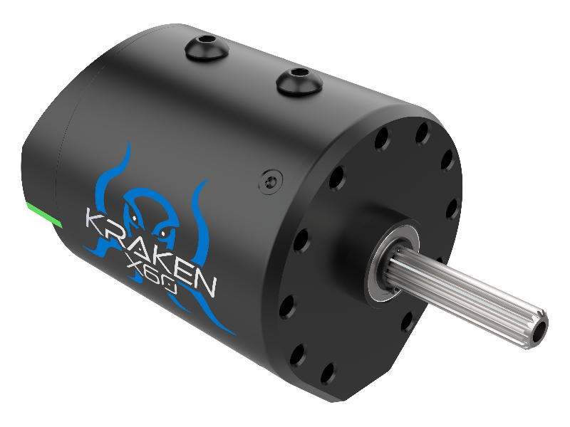
Phoenix 6 overview
Phoenix 6 is the main library for all CTRE CAN products. It has many advanced features that can provide advantages to teams who properly utilize it. The library also provides many functions that make it easier for teams to use it. However, we are not going over most of these features today because we are focusing on the basics of programming your motor controllers.

Slide 13
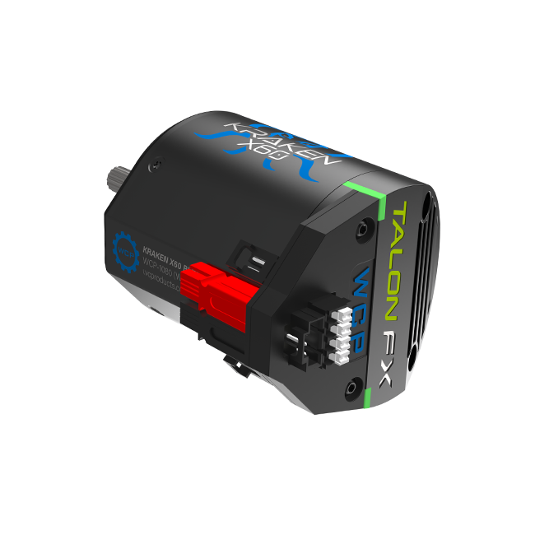
Phoenix 6 - Creating Motor Controller Objects
Inorder to control your TalonFX or TalonFXS using the Phoenix 6 Library, you must first create a motor controller object. You can follow these steps to create the motor object
Create an object in code that uses your motor controller, it is typically just the motor controller name with no spaces. In this example we are using TalonFX, so it will look like new TalonFX(1,new CANBUS(“Bus”));
The first parameter of the constructor is the CAN ID of the motor controller
The second parameter is the canbus that the controller is connected to. This parameter is completely optional, and can be left out if only using 1 can bus.

Slide 14
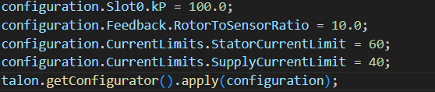
Phoenix 6 - Configuring the TalonFX Motor Controller in Code
You can configure your talonfx similar to a Spark series controller through a configuration named device name with no spaces + “Configuration”. However, it is very important that you read the documentation for each controller because the configuration categories for each variable are different, and the variable names are different. Phoenix 6 supports inline configuration through functions with the function simply being called “with”+<variable name>. You can finally configure a TalonFX or any phoenix 6 device by calling <motor controller object variable>.getConfigurator().apply(<configuration object variable>).

Slide 15
Phoenix 6 - Control Request API
The control request api is how you can control all CTRE devices in code. This api allows to customize the led output on the CANdle, and the motor output of your Krakens/Falcons. It is a simple api requiring the user create a control request object of the appropriate type and using device.setControl(object) to control the devices.
Here is a quick table of the type of desired output and appropriate type of control request.
CTRE also provides the motion magic and motion magic expo versions of all motor controlled output requests
Open Loop/Voltage | VoltageOut
TorqueCurrent (Requires PRO) | TorqueCurrentFOC
PWM style/Percentage | DutyCycleOut
Position | PositionVoltage/ TorqueCurrentFOC
Velocity | VelocityVoltage/ TorqueCurrentFOC
LED Pattern | Name+”Animation”

Slide 16
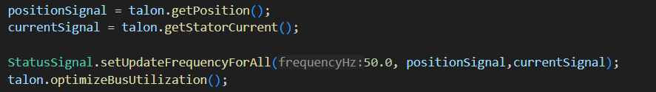
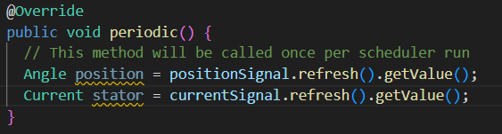
Phoenix 6 - Status Signal API
The status signal API is how you get data in Phoenix 6. Anyone who has used a TalonFX motor in code has to had to use this api. It provides some advanced features that allow you to optimize the can bus usage on your robot, while also being easy to use. You can define a status signal object by doing device.getx(), with x being the data you want to get such as position or stator current. This will return a status signal object with a sub type of a WPILib measure unit. In order to get the data from the status signal, you must first refresh with <signal object>.refresh(), and then you can do <signal object>.getValue().You can adjust how fast the status signal sends back data by changing the update frequency with set update frequency.

Slide 17
Thank You for your attention during this lesson. All of the example code in this slide show can be found on the github provided under the “WPILIB-MOTOR-EXAMPLE-CODE” folder.

